Slide 1
Capstone - The Battle of Neighborhoods

Slide 2
Introduction
Background
New York City's demographics show that it is a large and ethnically diverse metropolis. It is the largest city in the United States with a long history of international immigration. New York City was home to nearly 8.5 million people in 2014, accounting for over 40% of the population of New York State and a slightly lower percentage of the New York metropolitan area, home to approximately 23.6 million. Over the last decade the city has been growing faster than the region. The New York region continues to be by far the leading metropolitan gateway for legal immigrants admitted into the United States.
Throughout its history, New York City has been a major point of entry for immigrants; the term "melting pot" was coined to describe densely populated immigrant neighborhoods on the Lower East Side. As many as 800 languages are spoken in New York,making it the most linguistically diverse city in the world. English remains the most widely spoken language, although there are areas in the outer boroughs in which up to 25% of people speak English as an alternate language, and/or have limited or no English language fluency. English is least spoken in neighborhoods such as Flushing, Sunset Park, and Corona.
Due to it's diversity, here are different kinds of restaurants in New York city which offers different cuisines. Italian, chinese, Indian, Mediterranin to name a few.
Business Problem
The business problem we are currently posing is: how could we provide support to different people to list and visualise all major parts of New York City that has great Chinese restaurants?
Reference: (https://en.wikipedia.org/wiki/Demographics_of_New_York_City)

Slide 3
Data section
For this project we need following data:
New York City data that contains list Boroughs, Neighborhoods along with their latitude and longitude.
Data source : https://data.cityofnewyork.us/api/views/7t3b-ywvw/rows.json?accessType=DOWNLOAD
Description : This data set contains the required information. And we will use this data set to explore various neighborhoods of new york city.*
Chinese resturants in each neighborhood of new york city:
Data source : Foursquare APIs
Description : By using this api we will get all the venues in each neighborhood. We can filter these venues to get only Chinese resturants.
GeoSpace data:
Data source : https://data.cityofnewyork.us/City-Government/Borough-Boundaries/tqmj-j8zm
Description : By using this geo space data, we will get the New york Borough boundaries that will help us visualize the map

Slide 4
Approach
Collect the new york city data
Using FourSquare API we will find all venues for each neighborhood.
Filter out all venues that are Indian Resturants.
Find rating , tips and like count for each Indian Resturants using FourSquare API.
Using rating for each resturant , we will sort that data.
Visualize the Ranking of neighborhoods using folium library(python)

Slide 5
Questions that can be asked using the above mentioned datasets
What is best location in New York City for Chinese Cuisine ?
Which areas have potential Chinese Resturant Market ?
Which all areas lack Chinese Resturants ?
Which is the best place to stay if I prefer Chinese Cuisine ?

Slide 6
Analysis
Full Ananlysis and code can be found here: https://github.com/dsinghra123/DataScienceCapstone/blob/master/Capstone-The%20Btl%20of%20Nborhoods%20Notebook.ipynb

Slide 7
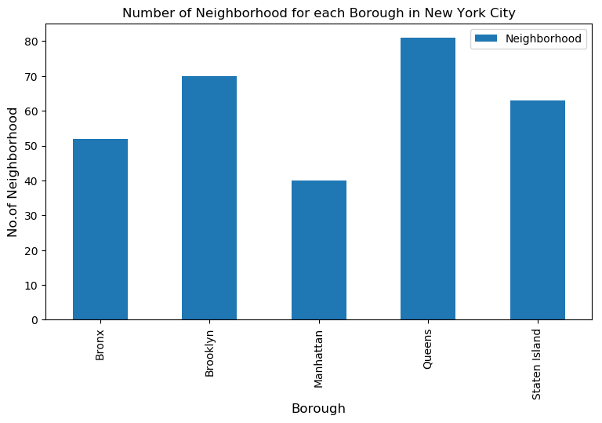
Results
1. We see that Queens has the highest number of Neighbourhoods

Slide 8
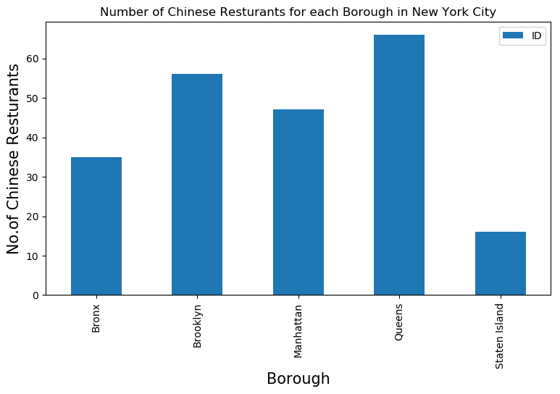
Contd…
2. Also, Queens has the highest number of Chinese Restaurants

Slide 9
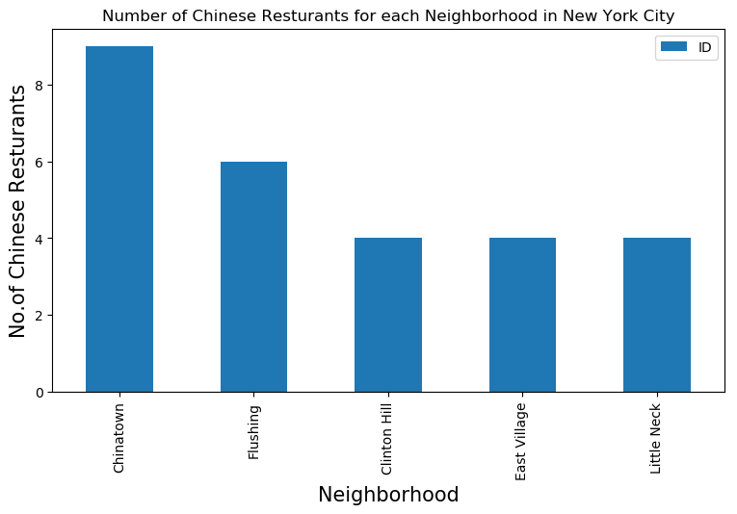
Contd…
3. Chinatown in Manhattan has the highest number of Chinese Restaurants with a total count of 9.

Slide 10
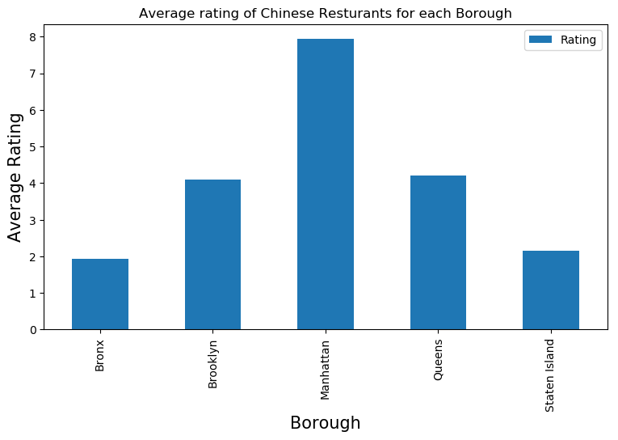
Contd…
4. Manhattan has the highest average rating for Chinese Restaurants.

Slide 11
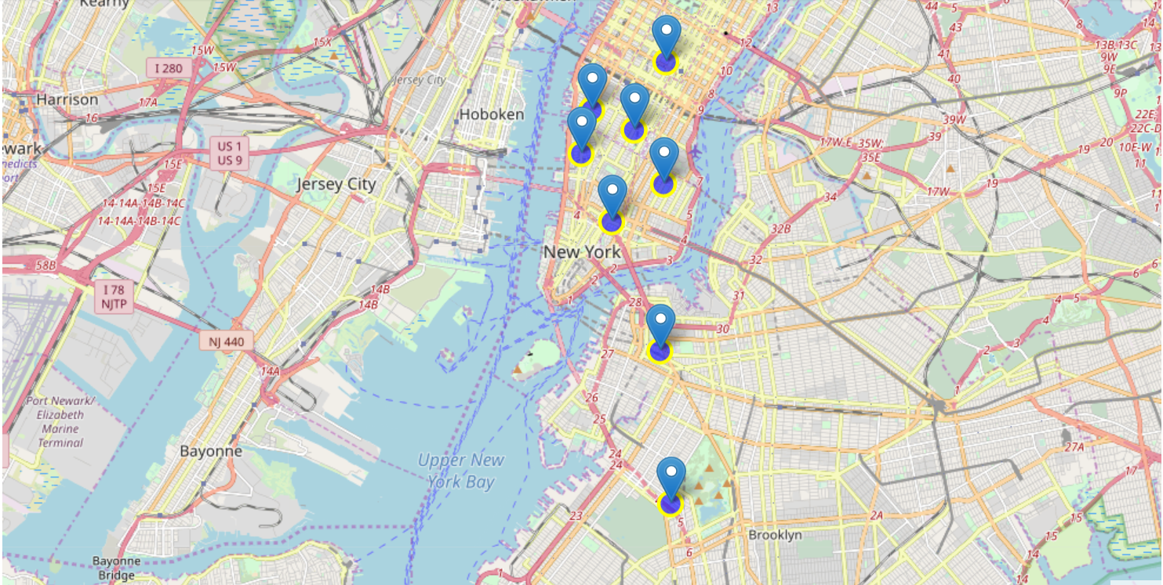
Contd…
5. Best neighbourhoods in New York that has highest average rating for Chinese Restaurants

Slide 12
Conclusion
Chelsea(Manhattan), Chelsea(State Island), Flatiron(Manhattan) are some of the best neighborhoods for Chinese cuisine.
Manhattan have potential Chinese Resturant Market.
Brooklyn ranks last in average rating of Chinese Resturants.
Manhattan is the best place to stay if you prefer Chinese Cuisine.

Slide 13
Limitation
The ranking is purely on basis of rating of resturants
The accuracy of data depends purely depends on the data provided by FourSquare

